Slide 1
Python Introduction
Dr. Naveen Kumar
Associate Professor
Amity Institute of Information Technology
Amity University Patna

Slide 2
Identifiers in Python
An identifier in Python is a user-defined name used to identify program elements such as variables, functions, classes, modules, or other objects. They are fundamental for making code readable, organized, and maintainable.

Slide 3
Rules for Naming Identifiers
Valid identifiers must adhere to the following rules:
Allowed Characters: An identifier can only contain letters (a-z, A-Z), digits (0-9), and underscores (_).
Starting Character: It must start with a letter or an underscore, never a digit.
No Special Characters/Spaces: Punctuation characters such as @, $, %, or spaces are not allowed.
No Keywords: An identifier cannot use any of Python's reserved keywords.
Case-Sensitive: Python is case-sensitive, meaning myVar and myvar are treated as two different identifiers.
Length: Identifiers can be of any length, though it is a best practice to keep them concise and meaningful.
import keyword
print(keyword.kwlist)

Slide 4
Reserved Keywords in Python
Category | Keywords
Value Keywords | True, False, None
Operator Keywords | and, or, not, is, in
Control Flow Keywords | if, else, elif, for, while, break, continue, pass, try, except, finally, raise, assert
Function and Class | def, return, lambda, yield, class
Context Management | with, as
Import and Module | import, from
Scope and Namespace | global, nonlocal
Async Programming | async, await

Slide 5
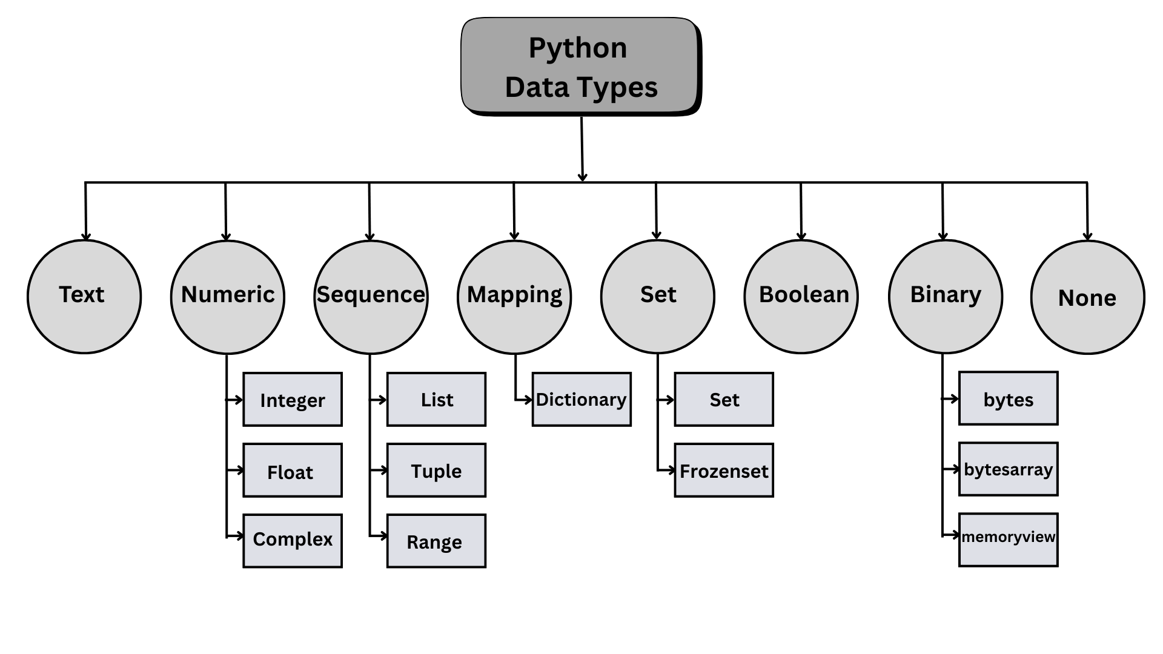

Slide 6
Basic Datatypes in Python
Python’s basic data types include int, float, complex, str, bytes, bytearray, and bool.
You can check a variable’s type using the type() function in Python.
You can convert data types in Python using functions like int(), float(), str(), and others.
Despite being dynamically typed, Python does have data types.
The most essential data types in Python can be categorized as numeric, sequence, binary, and Boolean.

Slide 8
Integers in python
Note: When a number in a non-decimal base is written directly in Python code, it must be prefixed with its base indicator (e.g., 0b1010, 0o12, 0xa). Python automatically interprets these as integers.
In Python, bin(), oct(), and hex() are built-in functions used to convert an integer to its string representation in binary, octal, and hexadecimal number systems, respectively.
The int() function is used to create an integer object from various number systems.
These functions take an integer as an argument and return a string with a specific prefix indicating the base of the number system.

Slide 9
Example
# Direct representation in Python
binary_num = 0b1010
octal_num = 0o12
hex_num = 0xa
print(f"{binary_num}, {octal_num}, {hex_num}") # Output: 10, 10, 10

Slide 10
Converting to a different Systemss
Function | Description | Returns String Prefix | Example | Result
bin() | Converts an integer to a binary string (base 2). | 0b | bin(10) | '0b1010'
oct() | Converts an integer to an octal string (base 8). | 0o | oct(10) | '0o12'
hex() | Converts an integer to a hexadecimal string (base 16) | 0x | hex(10) | '0xa'
int(x) | Converts the value x to a decimal integer. |  | int('10') | 10
int(x, base) | Converts the string x from a given base to a decimal integer. |  | int('1010', 2) int('12’, 8) int(‘a’, 16) | 10 10 10

Slide 11
We can use resultant string slicing [2:] or the format() function to remove the prefixes if needed.
decimal_num = 10
print(bin(decimal_num)[2:]) # Output: 1010
print(format(decimal_num, 'o')) # Output: 12
print(f'{decimal_num:x}') # Output: a
The int() function is versatile. When used with a single argument, it converts the argument (which can be a number or a string) into a decimal integer.
When used with two arguments, int(x, base), it converts a string representation x from the specified base (from 2 to 36) into a base-10 integer.

Slide 12
In Python, the complex data type is a built-in numeric type used to represent complex numbers, which have both a real and an imaginary part. They are primarily used in scientific and engineering applications.
Representation
A complex number in Python is written in the form of a + bj, where:
a is the real part (a float).
b is the imaginary part (a float).
j (or J) is the imaginary unit, representing the square root of -1 (√-1).

Slide 13
Creating Complex Number
Complex numbers can be created using:
Literals: Directly writing the number with the j suffix, such as 3 + 5j.
The complex() function:
  complex(real, imaginary) returns a complex number with the specified parts.
  complex(string) parses a string representation of a complex number (e.g., '1+1j').
Key Features and Operations
Accessing parts: You can access the real and imaginary components using the .real and .imag attributes.
z = 3 + 4j
print(z.real) # Output: 3.0
print(z.imag) # Output: 4.0

Slide 14
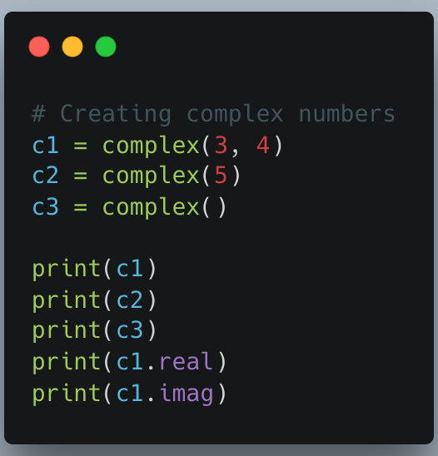
Arithmetic operations: Standard arithmetic operations (+, -, *, /) are supported for complex numbers, as well as mixed arithmetic with integers and floats.
Conjugate: The complex conjugate can be obtained
using the .conjugate() method.
Advanced functions: For advanced mathematical
functions (e.g., phase, polar coordinates), Python
provides the built-in cmath module.

Slide 15
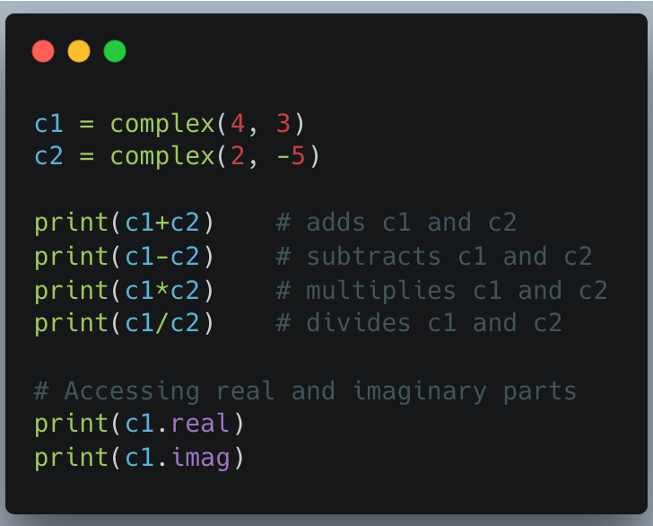

Slide 16
type() and id() built-in functions
In Python, every item of data is an object with a unique identity and a specific type.
The built-in id() function returns the object's unique integer identifier, which is constant throughout its lifetime in memory.
The built-in type() function returns the class (type) of the object passed to it.
The id() function takes a single object as a parameter and returns its identity as an integer. In the CPython implementation, this number is the memory address of the object. The primary use of id() is to determine if two variables refer to the exact same object in memory.
Syntax: id(object)
Return Value: A unique and constant integer identifier for the object.
Use Case: Often used for debugging and understanding Python's memory management, especially with mutable and immutable types. The is operator is a more common way to check if two objects have the same identity (x is y is equivalent to id(x) == id(y)).

Slide 17
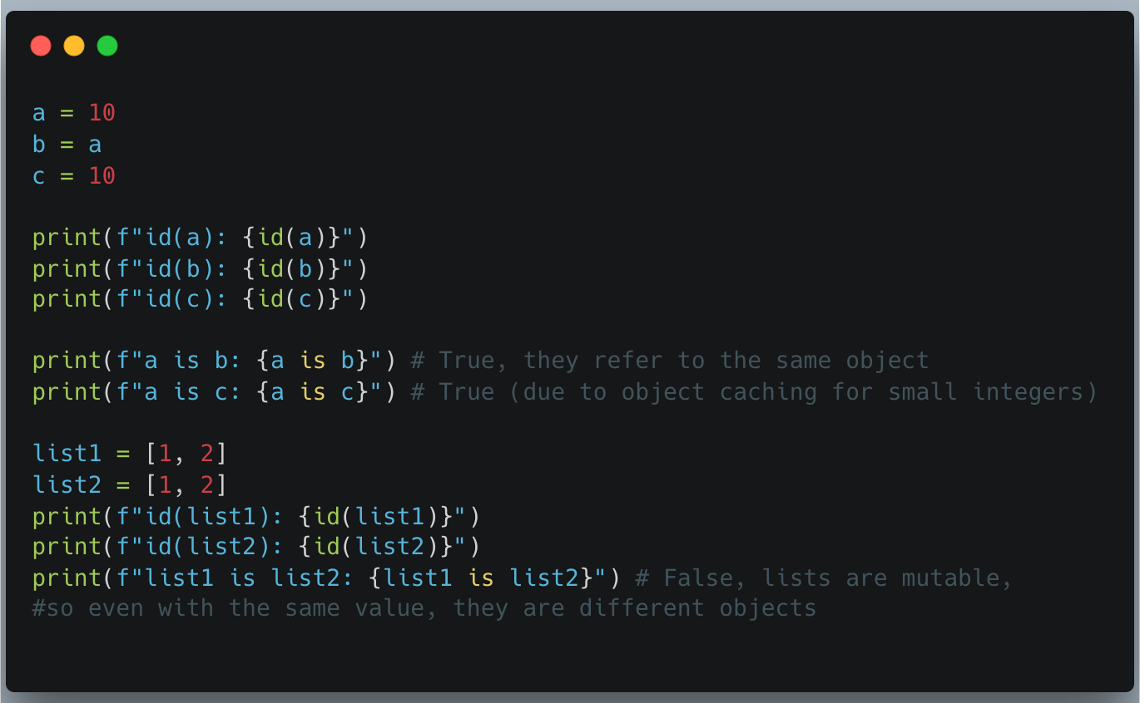

Slide 18
The type() function has two distinct forms. The most common form takes a single object as a parameter and returns its type (class).
Syntax (Single Argument): type(object)
Return Value (Single Argument): The class object of the given object (e.g., <class 'int'>, <class 'str'>).
Use Case: Primarily used for dynamic type checking and debugging, or for type-based dispatch in functions.

Slide 19
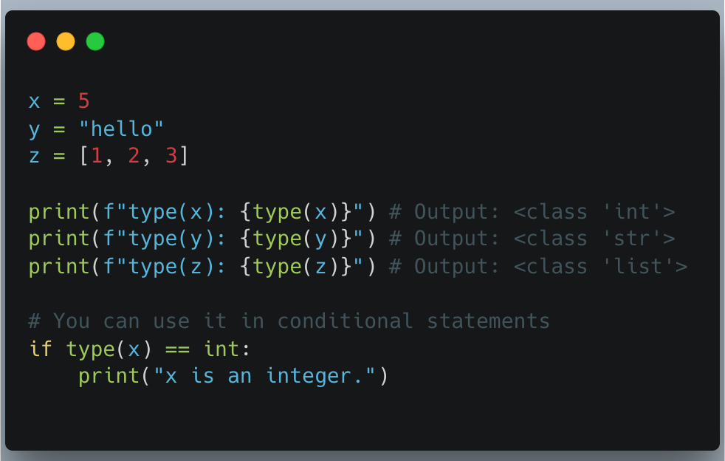

Slide 20
String in python
In Python, a string (str) is an immutable sequence of Unicode characters used for handling text. Strings are a built-in data type and can be created using single quotes ('...'), double quotes ("..."), or triple quotes ("""...""" or '''...''') for multi-line strings.
Python provides a rich set of built-in methods for efficient text manipulation and processing. String methods return new string objects and do not change the original string because strings in Python are immutable.

Slide 21
Key Concepts
Immutability: Once a string is created, its characters cannot be changed. Any operation that appears to modify a string, such as replacing a substring or changing its case, actually creates a new string.
Indexing: Characters in a string can be accessed by their position (index), starting from 0 for the first character. Negative indexing is also supported, where ­1 refers to the last character.
Slicing: You can extract a portion (substring) of a string using slice syntax: string[start:end] or string[start:end:step].
No Character Type: Python does not have a separate character type; a single character is simply a string of length one.

Slide 22
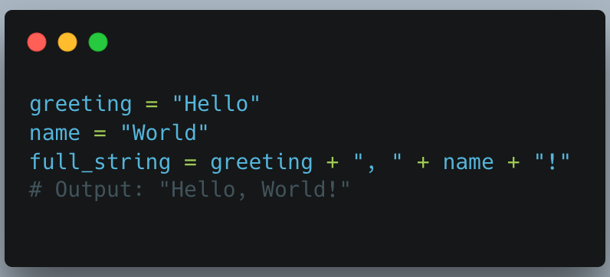
Common Operations and Methods
Python provides many built-in functions and string methods for working with text.
Concatenation: Join two or more strings using the + operator.

Slide 23
Repetition: Repeat a string multiple times using the * operator.
print("la" * 3) # Output: "lalala”
Length: Use the len() function to get the number of characters in a string.
s = "Python"
length = len(s)
# length is 6
Formatting: F-strings (formatted string literals) are the recommended way to embed variables within strings.
name = "Jane"
age = 30
print(f"My name is {name} and I am {age} years old.")
# Output: "My name is Jane and I am 30 years old."

Slide 24
Case Modification
lower(): Converts all characters in the string to lowercase.
upper(): Converts all characters in the string to uppercase.
capitalize(): Converts the first character of the string to uppercase and the rest to lowercase.
title(): Converts the first character of each word to uppercase.
swapcase(): Swaps the case of all characters (uppercase becomes lowercase and vice versa).
casefold(): Similar to lower(), but removes all case distinctions for caseless matching across different languages and alphabets.

Slide 25
Searching and Finding
find(sub): Returns the lowest index where the substring sub is found, or -1 if not found.
index(sub): Similar to find(), but raises a ValueError exception if the substring is not found.
count(sub): Returns the number of occurrences of the substring sub in the string.
startswith(prefix): Checks if the string starts with the specified prefix, returning True or False.
endswith(suffix): Checks if the string ends with the specified suffix, returning True or False.

Slide 26
Trimming and Replacing
strip(chars): Removes leading and trailing whitespace or a specified set of characters.
lstrip(chars): Removes leading characters only.
rstrip(chars): Removes trailing characters only.
replace(old, new): Replaces all occurrences of the substring old with new.
removeprefix(prefix): Removes a specified prefix from the beginning of the string if it exists.
removesuffix(suffix): Removes a specified suffix from the end of the string if it exists.

Slide 27
Splitting and Joining
split(sep): Splits the string into a list of substrings using a specified separator (sep); if no separator is given, it splits on all whitespace.
join(iterable): Concatenates elements of an iterable (e.g., a list of strings) into a single string using the string itself as the separator.
splitlines(): Splits the string at line breaks (\n, \r, etc.) and returns a list of lines.

Slide 28
Formatting and Validation
format(): Formats values into a string using placeholders ({}).
isalnum(): Returns True if all characters are alphanumeric (letters or numbers).
isalpha(): Returns True if all characters are in the alphabet.
isdigit(): Returns True if all characters are digits.
isspace(): Returns True if the string contains only whitespace characters.

Slide 29
print() function in python
The print() function in Python is a built-in function used to display output to the console (standard output device). It can take one or more objects as arguments, converts them to strings, and displays them.
print(*objects, sep=' ', end='\n', file=sys.stdout, flush=False)

Slide 30
Parameters of print() function
The print() function accepts the following parameters:
*objects: The values to be printed. It can accept any number of objects of any data type (strings, numbers, lists, etc.), which are converted to strings before printing.
sep='separator' (Optional): Specifies the separator between multiple objects if more than one is provided. The default is a single space (' ').
end='end' (Optional): Specifies what to print at the end of the output. The default is a newline character ('\n'), which causes the next print statement to start on a new line.
file (Optional): An object with a write method, specifying where the output should be sent (e.g., a file). The default is sys.stdout (the screen/console).
flush (Optional): A boolean value. If True, the output is forced to appear immediately; otherwise, it is buffered (delayed) by default. The default is False.

Slide 31
Examples: print()
Basic usage: Printing a simple message.
print("Hello, World!")
# Output: Hello, World!
Printing variables and multiple items: Items separated by commas are automatically spaced.
name = "Alice"
age = 25
print("Hello, my name is", name, "and I am", age, "years old.")
# Output: Hello, my name is Alice and I am 25 years old.
Using sep parameter: Changing the separator between items.
print("Python", "is", "fun", sep="-")
# Output: Python-is-fun

Slide 32
Examples: print()
Using end parameter: Preventing a newline at the end of the line.
print("This is on one line...", end="")
print(" and this is on the same line.")
# Output: This is on one line... and this is on the same line.
Printing to a file: Redirecting the output to a text file.
with open("output.txt", "w") as f:
print("Welcome to WsCube Tech!", file=f)
# The text "Welcome to WsCube Tech!" is written to output.txt
Using f-strings for formatting: A modern and preferred way to embed expressions within strings.
OrgName = "Tutorials Point"
location = "India"
print(f"{OrgName} is located in {location}.")
# Output: Tutorials Point is located in India.

Slide 33
input() function in python
The input() function in Python is a built-in method used to get data from a user via the keyboard during program execution.
The program pauses until the user types something and presses the Enter key.
The function then reads the line of input and always returns it as a string.
Syntax: variable_name = input("Optional prompt message")
"Optional prompt message" is a string displayed to the user to guide them on what input is expected.
The entered value is stored in variable_name as a string.

Slide 34
Key Features and Examples
1. Basic Input: The simplest use case is capturing a single string value.
name = input("Enter your name: ")
print("Hello, " + name + "!")
If the user enters ”Amity", the output will be:
Enter your name: Amity
Hello, Amity!

Slide 35
2. Taking Numeric Input (Type Conversion)
Since input() always returns a string, you must use type casting functions like int() or float() to perform mathematical operations.
Integer input:
age = int(input("Enter your age: "))
print("Next year, you will be", age + 1, "years old.")
If the user enters "25", the output will be:
Enter your age: 25
Next year, you will be 26 years old.

Slide 36
Float input:
price = float(input("Enter the price: "))
print("Total price with tax:", price * 1.18)
3. Taking Multiple Inputs in One Line
You can accept multiple values separated by a delimiter (like a space or comma) in a single line using the split() method.
x, y = input("Enter two numbers separated by a space: ").split()
sum_of_numbers = int(x) + int(y)
print("The sum is:", sum_of_numbers)
If the user enters "5 10", the output will be:
Enter two numbers separated by a space: 5 10
The sum is: 15

Slide 37
Alternatively, you can use map() for cleaner conversion of multiple inputs to a specific type:
m, n = map(int, input("Enter two numbers: ").split())
print("Sum:", m + n)
4. Handling Input Errors
If a user enters an invalid type (e.g., a string when an integer is expected), a ValueError will occur. Using a try-except block can help handle these exceptions gracefully.
while True:
try:
number = int(input("Enter an integer: "))
break # Exit the loop if input is valid
except ValueError:
print("Invalid input! Please enter a valid integer.")
print("You entered:", number)

Slide 38
Formatted input and f-string in Python
In Python, input is handled with the input() function and output with the print() function. Formatting is primarily achieved using f-strings (formatted string literals), the str.format() method, or the older % operator.
The built-in input() function reads a line from the user and returns it as a string. To use the input as another data type (like an integer or a float), you must perform explicit type conversion (typecasting).
Basic Input:
name = input("Enter your name: ")
print(f"Hello, {name}!")

Slide 39
Integer Input:python
age = int(input("Enter your age: "))
print(f"You are {age} years old.")
Multiple Inputs in one line:
# Enter numbers separated by spaces, e.g., '10 20’
x, y = map(int, input("Enter two numbers separated by space: ").split())
print(f"First number: {x}, Second number: {y}")

Slide 40
Formatted Output
The print() function sends output to the console. It supports formatting via special methods or literal strings.
Basic Output:
print("Hello, World!")
Custom Separator/End Characters:
You can use the sep argument to change the separator between multiple items and the end argument to change the character printed at the end of the line (default is a newline \n).
print("My", "Name", "Is", "James", sep="**", end=".")
# Output: My**Name**Is**James.

Slide 41
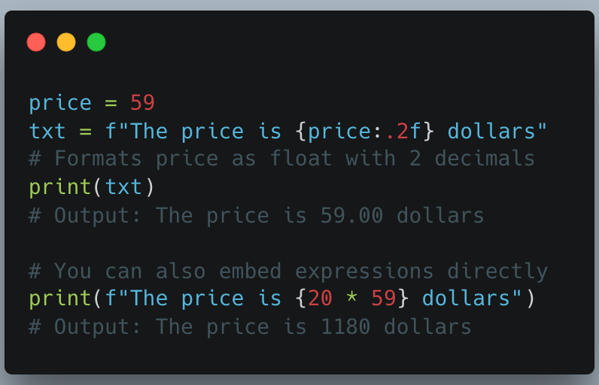
F-Strings (Recommended in modern Python 3):
Prefix the string with f and place variables/expressions inside curly braces {}.

Slide 42
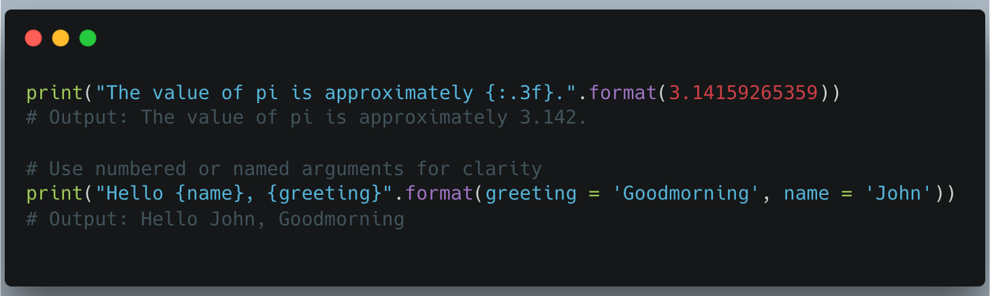
The str.format() Method:
Uses curly braces as placeholders and the .format() method to substitute values.

Slide 43
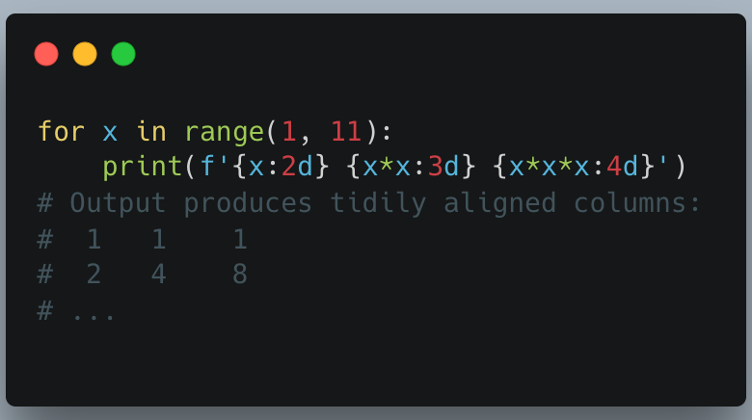
Alignment and Width with F-strings or str.format():
You can control alignment (< left, > right, ^ center) and field width.

Slide 44
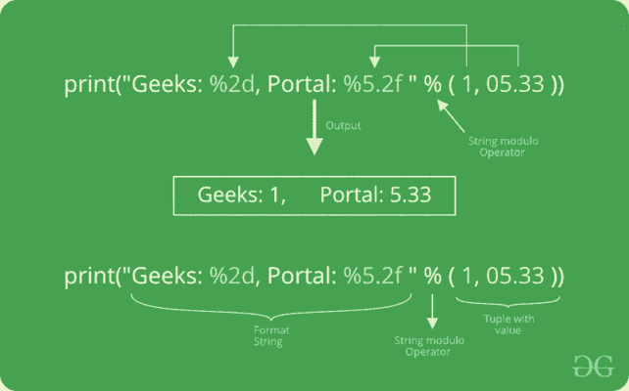
Formatting Output using String Modulo Operator(%)

Slide 45
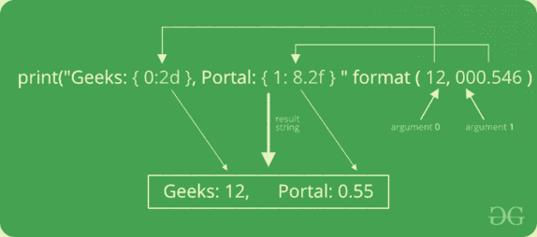
Formatting Output using The Format Method

Slide 47
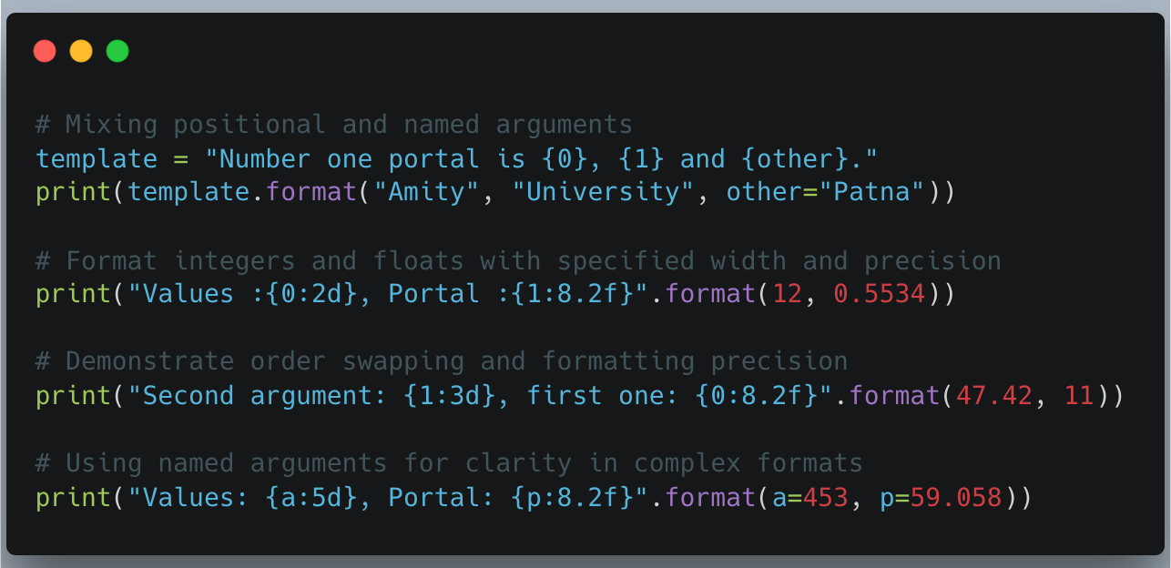
Advanced Usage with Positional and Named Parameters

Slide 48
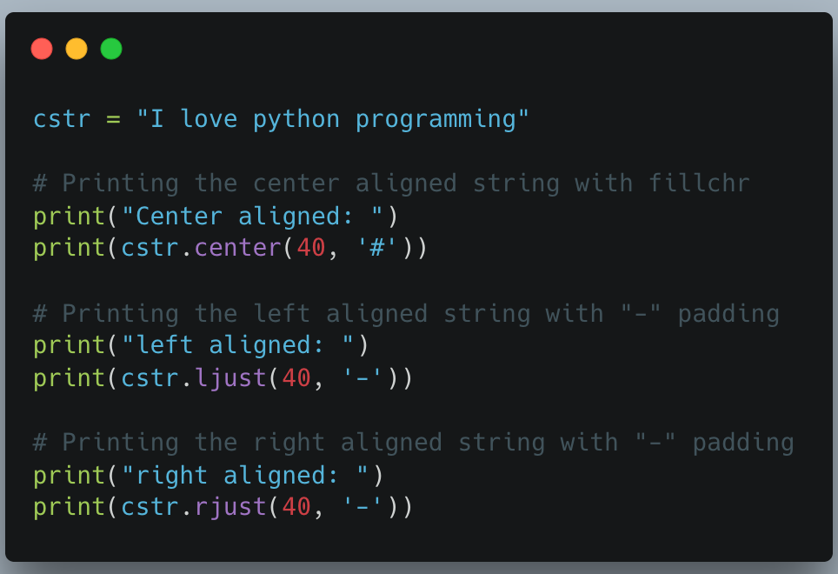
Formatting Output using String Method

Slide 49
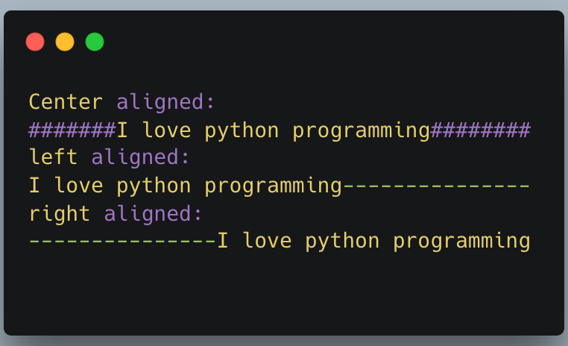

Slide 50
Format Conversion Rule
Conversion | Meaning
d | Decimal integer
b | Binary format
o | octal format
u | Obsolete and equivalent to 'd'
x or X | Hexadecimal format
e or E | Exponential notation
f or F | Floating-point decimal
g or G | General format
c | Single Character
r | String format(using repr())
s | String Format(using str()))
% | Percentage

Slide 51
Set in Python
In Python, a set is an unordered collection of unique, immutable elements. Sets are highly optimized for membership testing and eliminating duplicates from other collections like lists or tuples.
Key Characteristics of Python Sets
Unique Elements: Duplicates are automatically removed.
Unordered: The order of items is not guaranteed and can change.
Unindexed: Elements cannot be accessed by index.
Mutable (mostly): Elements can be added or removed, but the elements themselves must be of immutable types.

Slide 52
Accessing Set element
Accessing elements in a set is different from data structures like lists or arrays because sets are fundamentally unordered collections that do not support indexing. This means you cannot directly access an element by its position (e.g., my_set[0]).
Instead, the common ways to access or interact with set elements across different programming languages are:
Membership Testing
The most efficient and common way to "access" a set element is to check if a specific value exists using a membership operator.
In Python: Use the in keyword.
Iteration (Looping)
You can process every item in a set one by one using a loop.
In Python: Use a for loop. The order of elements is not guaranteed
my_set = {"apple", "banana", "cherry"}
for item in my_set:
print(item)

Slide 53
Converting to an Ordered Collection
If you need to access elements by index (position), you must first convert the set to a data structure that supports indexing, such as a list or array.
In Python: Convert using the list() function, then access by index.
my_set = {"apple", "banana", "cherry"}
my_list = list(my_set)
first_element = my_list[0]
Unordered, Unindexed and Mutability

Slide 54
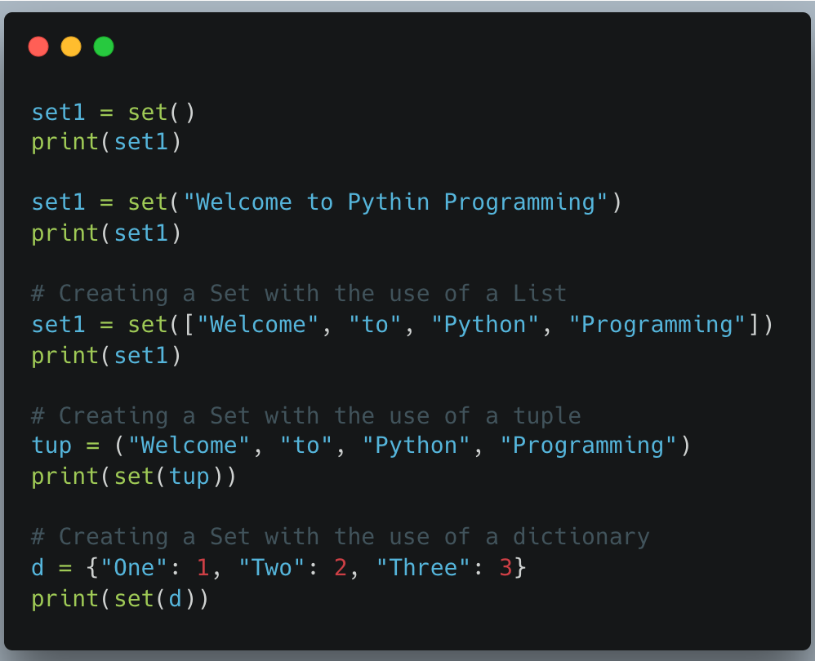

Slide 55
Create a Set
Sets can be created using curly braces {} or the set() constructor.
Use curly braces for non-empty sets: {"apple", "banana"}. Duplicates are removed automatically, e.g., {1, 2, 2} becomes {1, 2}.
Use set() to create an empty set, as {} creates an empty dictionary.
Convert iterables (like lists) to a set using set(iterable) to remove duplicates.

Slide 56
Adding Elements to a Set in Python
We can add items to a set using add() method and update() method. add() method can be used to add only a single item.
To add multiple items we use update() method.
# Creating a set
set1 = {1, 2, 3}
# Add one item
set1.add(4)
# Add multiple items
set1.update([5, 6])
print(set1)

Slide 57
Removing Elements from the Set in Python
We can remove an element from a set in Python using several methods: remove(), discard() and pop(). Each method works slightly differently :
Using remove() Method or discard() Method
Using pop() Method
Using clear() Method

Slide 58
Removing Elements from Set
# Using Remove Method
set1 = {1, 2, 3, 4, 5}
set1.remove(3)
print(set1)
# Attempting to remove an element that does not exist
try:
set1.remove(10)
except KeyError as e:
print("Error:", e)
# Using discard() Method
set1.discard(4)
print(set1)
# Attempting to discard an element that does not exist
set1.discard(10) # No error raised
print(set1)

Slide 59
Removing Elements from Set
set1 = {1, 2, 3, 4, 5}
val = set1.pop()
print(val)
print(set1)
# Using pop on an empty set
set1.clear() # Clear the set to make it empty
try:
set1.pop()
except KeyError as e:
print("Error:", e)
set1 = {1, 2, 3, 4, 5}
set1.clear()
print(set1)

Slide 60
Common Set Operations and Methods
Operation | Method | Operator | Description
Union | A.union(B) | A | B | Combines all unique elements.
Intersection | A.intersection(B) | A & B | Finds common elements.
Difference | A.difference(B) | A - B | Elements in A but not in B.
Symmetric Diff. | A.symmetric_difference(B) | A ^ B | Elements in either set, but not both.
Add | A.add(item) |  | Adds a single element.
Remove | A.remove(item) |  | Removes an element (raises KeyError if not found).
Discard | A.discard(item) |  | Removes an element (does nothing if not found).

Slide 61
Frozen Sets
A frozenset is an immutable version of a set. Its elements cannot be changed after creation, but you can perform operations like union, intersection and difference. Use frozenset() to create one.

Slide 62
Operators | Notes
key in s | containment check
key not in s | non-containment check
s1 == s2 | s1 is equivalent to s2
s1 != s2 | s1 is not equivalent to s2
s1 <= s2 | s1 is subset of s2
s1 < s2 | s1 is proper subset of s2
s1 >= s2 | s1 is superset of s2
s1 > s2 | s1 is proper superset of s2
s1 | s2 | the union of s1 and s2
s1 & s2 | the intersection of s1 and s2
s1 - s2 | the set of elements in s1 but not s2
s1 ˆ s2 | the set of elements in precisely one of s1 or s2

Slide 63
Typecasting Objects into Sets
# Typecasting list into set
li = [1, 2, 3, 3, 4, 5, 5, 6, 2]
set1 = set(li)
print(set1)
# Typecasting string into set
s = ”Welcome to Python Programming"
set1 = set(s)
print(set1)
# Typecasting dictionary into set
d = {1: "One", 2: "Two", 3: "Three"}
set1 = set(d)
print(set1)

Slide 64
Functions Name | Description
add() | Adds a given element to a set
clear() | Removes all elements from the set
copy() | Returns a shallow copy of the set
difference() | Returns a set that is the difference between two sets
difference_update() | Updates the existing caller set with the difference between two sets
discard() | Removes the element from the set
frozenset() | Return an immutable frozenset object
intersection() | Returns a set that has the intersection of all sets
intersection_update() | Updates the existing caller set with the intersection of sets
isdisjoint() | Checks whether the sets are disjoint or not
issubset() | Returns True if all elements of a set A are present in another set B
issuperset() | Returns True if all elements of a set A occupies set B
pop() | Returns and removes a random element from the set
remove() | Removes the element from the set
symmetric_difference() | Returns a set which is the symmetric difference between the two sets
symmetric_difference_update() | Updates the existing caller set with the symmetric difference of sets
union() | Returns a set that has the union of all sets
update() | Adds elements to the set

Slide 65
Shallow Copy vs Deep Copy
In Python, copying objects involves two primary methods that differ in how they handle nested mutable objects: shallow copy and deep copy.

Slide 66
1. Shallow Copy
A shallow copy creates a new compound object (like a list or dictionary) but inserts references to the original nested objects it contains. This means:
Top-level independence: The new outer container is a separate entity in memory from the original, so modifications to the container itself (e.g., adding or removing an element) won't affect the original.
Nested object dependence: If the object contains mutable elements (like nested lists or dictionaries), both the original and the copy will refer to the same inner objects. Modifying a nested object in one will cause the change to be reflected in the other.

Slide 67
Common ways to create a shallow copy include
Using the copy() method for lists, dictionaries, and sets (e.g., old_list.copy()).
Using slicing (e.g., old_list[:]) for lists and other sequences.
Using the constructor of the type (e.g., list(old_list), dict(old_dict), set(old_set)).
Using the function copy.copy(obj) from the copy module.

Slide 68
2. Deep Copy
A deep copy creates a new object and recursively creates copies of all nested objects found within the original. This means:
Complete independence: The original and the copied object are entirely independent. Changes made to the copy (even to nested elements) will not affect the original, and vice versa.
Use cases: Deep copies are necessary when working with complex, nested data structures where you need to ensure complete isolation between the copy and the original object.

Slide 69
Way to create deep copy
Method: The only way to create a deep copy in Python's standard library is by using the copy.deepcopy(obj) function from the copy module.

Slide 70
Key Differences Summary
Aspect | Shallow Copy | Deep Copy
Copying Behavior | Duplicates the top-level container, shares references to inner elements. | Recursively duplicates the entire object hierarchy, including all nested elements.
Independence | Changes to mutable inner elements affect both the original and the copy. | Changes to any part of the copy do not affect the original.
Memory Usage | Uses less memory because it reuses nested objects. | Uses more memory as it duplicates all elements.
Performance | Faster to create. | Slower due to recursive copying.

Slide 71
Dictionary in Python
A dictionary in Python is a built-in data type that stores data as flexible, changeable key-value pairs.
Keys are unique and must be immutable data types (like strings, numbers, or tuples), while values can be of any data type.
Dictionaries are highly efficient for data retrieval using a key, implemented as a hash map (average O(1) time complexity for lookups).

Slide 72
Key Characteristics
Ordered: As of Python version 3.7, dictionaries are ordered, meaning the insertion order of items is preserved.
Changeable (Mutable): You can add, modify, or remove items after a dictionary has been created.
No Duplicates: Dictionary keys must be unique. Assigning a value to an existing key will overwrite the old value.
Indexed by Keys: Data is accessed using its associated key, not an integer index like in a list.

Slide 73
Basic Operations and Examples
1. Creation
2. Accessing Values
3. Adding and Modifying Items
4. Removing Items

Slide 74
1. Creation
You can create a dictionary using curly braces {} or the dict() constructor.
# Using curly braces (dictionary literal)
person = {
"name": "Alice",
"age": 30,
"role": "Engineer"
}
print(person)
# Output: {'name': 'Alice', 'age': 30, 'role': 'Engineer'}
# Using the dict() constructor
employee_dict = dict(name="Alice", age=30, role="Engineer")
print(employee_dict)
# Output: {'name': 'Alice', 'age': 30, 'role': 'Engineer'}

Slide 75
2. Accessing Values
Values are accessed using their key within square brackets [] or the .get() method. The .get() method is safer as it avoids a KeyError if the key does not exist, returning None or a specified default value instead.
print(person["name"])
# Output: Alice
# Using .get() method
print(person.get("email", "Not available"))
# Output: Not available

Slide 76
3. Adding and Modifying Items
You can add new key-value pairs or change existing values using the assignment operator =.
person["email"] = "alice@example.com" # Add a new key-value pair
person["age"] = 31 # Modify an existing value
print(person)
# Output: {'name': 'Alice', 'age': 31, 'role': 'Engineer', 'email': 'alice@example.com’}
The .update() method can be used to add multiple items from another dictionary or iterable.

Slide 77
4. Removing Items
Items can be removed using the del keyword or dictionary methods like .pop() and .clear().
# Using del
del person["role"]
print(person)
# Output: {'name': 'Alice', 'age': 31, 'email': 'alice@example.com'}
# Using .pop() (removes key and returns value)
removed_email = person.pop("email")
print(person)
# Output: {'name': 'Alice', 'age': 31}
print(removed_email)
# Output: alice@example.com

Slide 78
Removing Dictionary Items
Dictionary items can be removed using built-in deletion methods that work on keys:
del: removes an item using its key
pop(): removes the item with the given key and returns its value
clear(): removes all items from the dictionary
popitem(): removes and returns the last inserted key–value pair

Slide 79
Common Dictionary Methodss
Python provides several built-in methods for working with dictionaries:
.keys(): Returns a view object of all the keys.
.values(): Returns a view object of all the values.
.items(): Returns a view object of key-value pairs as tuples.
.clear(): Removes all elements from the dictionary.
.copy(): Returns a shallow copy of the dictionary.

Slide 80
Iterating Through a Dictionary
A dictionary can be traversed using a for loop to access its keys, values or both key-value pairs by using the built-in methods keys(), values() and items().
d = {1: 'Geeks', 2: 'For', 'age':22}
# Iterate over keys
for key in d:
print(key)
# Iterate over values
for value in d.values():
print(value)
# Iterate over key-value pairs
for key, value in d.items():
print(f"{key}: {value}")

Slide 81
Nested Dictionaries
A nested dictionary is a dictionary that contains another dictionary as one of its values. Below diagram shows how a nested dictionary works, where key 3 points to another dictionary inside the main dictionary.
d = {1: 'Geeks', 2: 'For', 3: {'A': 'Welcome', 'B': 'To', 'C': 'Geeks'}}
print(d)

